Slide 1
Introduction to Information Retrieval
Sarawoot Kongyoung

Slide 2


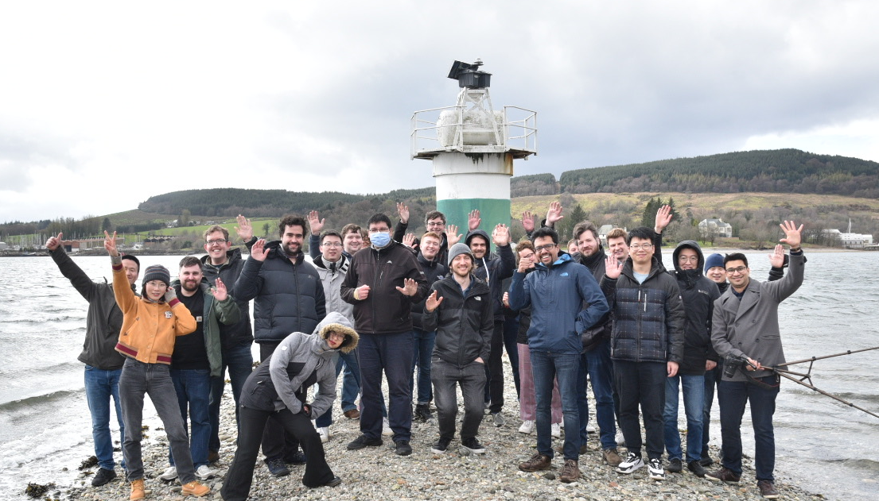
Founded in 1986 by Professor C. J. van Rijsbergen (F1 Score)

Slide 3




Large Language Models (LLMs)

Slide 4



Task/domain specific
dataset
Generation (LLM)
Fine-tuning
Response
Query
{ }
Pre-training
Response
Gigantic dataset
(web, wiki, books, news, etc)
LLM (Generation)
Q/A System
User

Slide 5
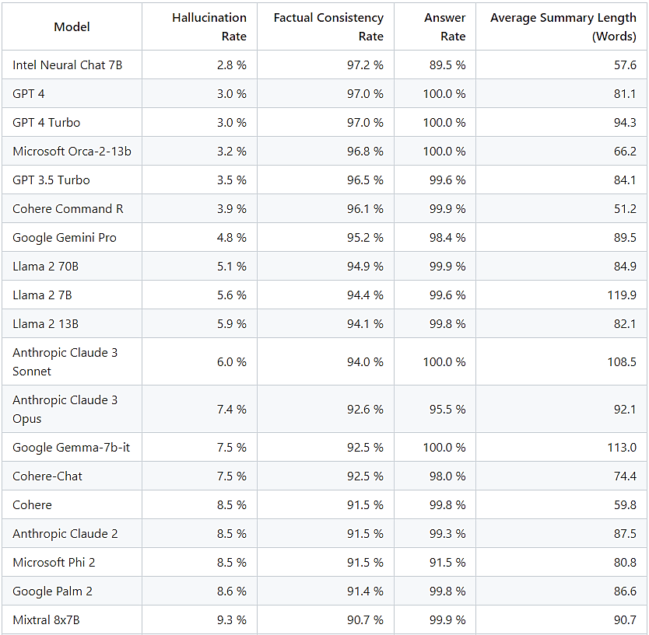
Hallucination
LLM hallucinations occur when a large language model (LLM) generates a response that is factually incorrect, nonsensical, or disconnected from the input prompt.
https://github.com/vectara/hallucination-leaderboard

Slide 6
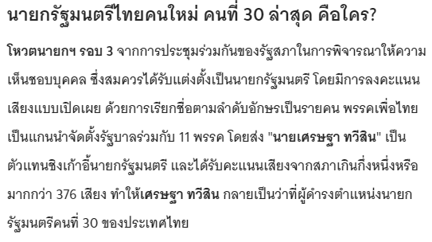
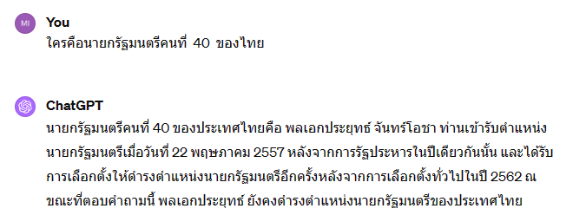
Hallucination
https://www.thairath.co.th/news/politic/2709339

Slide 7
Caused?
Insufficient training data
Incorrect assumptions made by the model
Biases in the data used to train the model

Slide 8
How to reduce hallucinate in LLM?

Slide 9




Task/domain specific
dataset
RAG = Retrieval + Generation (LLM)
Fine-tuning
Response
Query
{ }
Pre-training
Response
Gigantic dataset
(web, wiki, books, news, etc)
LLM (Generation)
Q/A System
User
Search
Reduce Hallucinate
Query + relevant docs
Knowledge/documents
Retrieval

Slide 10
RAG: Retrieval Augmented Generation
Dense
Input
Query
Encoder
Generator
Documents
Prompt
Output
Doc
Encoder
Retriever
Context
Faiss
Vector Index

Slide 11
RAG: Retrieval Augmented Generation
How to encode queries?
How to chunk?
Input
Query
Encoder
Generator (LLM)
Documents
Prompt
Output
When to retrieve?
Doc
Encoder
Retriever
Context
How to encode docs?
How and what do I retrieve?
Faiss
Vector Index

Slide 12
What is Information Retrieval (IR)?

Slide 13

What is Information Retrieval (IR)?
Information Retrieval is the science of search engines
How best to address the information needs of users…
• Effectively: Get the right information to a user!
• Efficiently: Get it to users quickly!

Slide 14


Information Needs
กลางวันจะกินอะไรดี

Slide 15
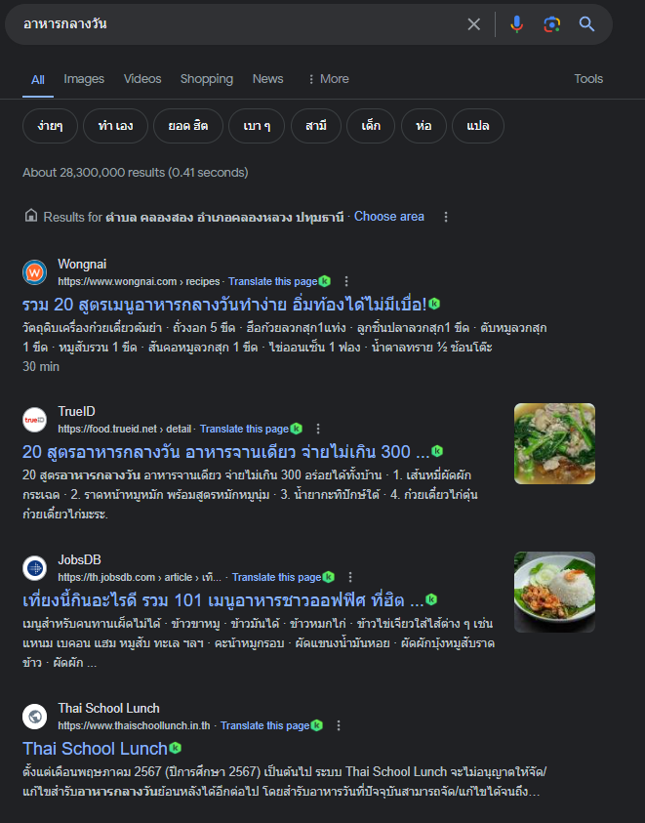
Information Needs

Slide 16
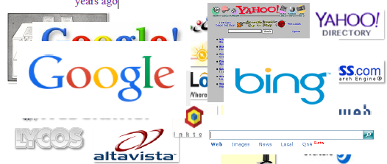
Search Engines
The most visible application of information retrieval technologies are search engines
Search engines have evolved since their initial conception 70 years ago

Slide 17
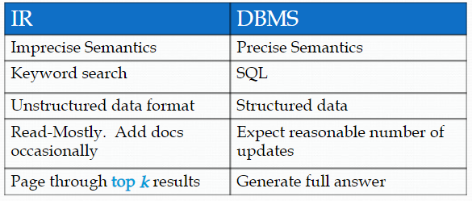
IR vs DBMS

Slide 18


An IR System
Query
terms
Retrieval
System
Document Collection
Ranked
Documents

Slide 19
Relevance ... Effectiveness ...Efficiency
Relevance
If the query and the document are about the same topic (known as the Topical Relevance) – Remember that a user's query can be vague!!
Effectiveness
Looks into the quality of the retrieved set. Do they largely contain relevant documents? (role of Retrieval Models)
Efficiency
Return results as fast as possible (role of search engine architecture - indexes) – architecture of the IR systems: distributing computation, updating indexes, etc.

Slide 20
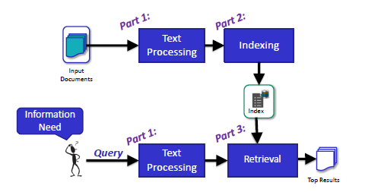
The Retrieval Process:

Slide 21
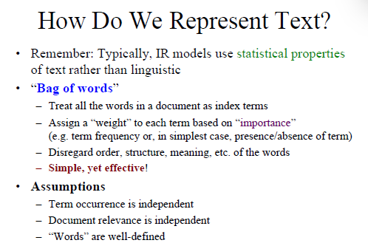
PART 1: TEXT PROCESSING

Slide 22
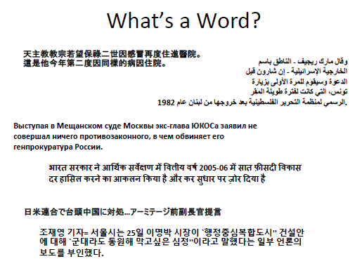

Slide 23
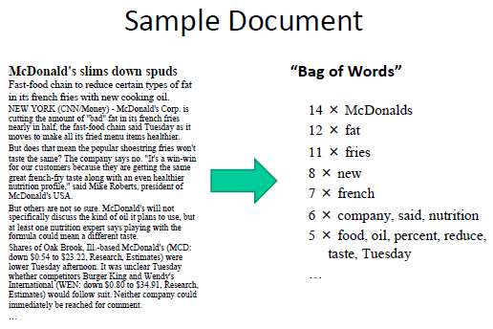

Slide 24
Tokenization
The quick brown fox jumps over the lazy dog.
Tokenization

Slide 25
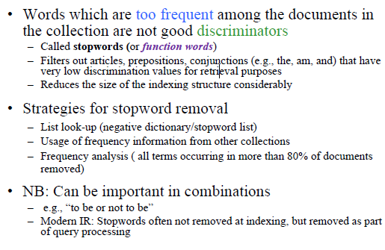
Stopwords Removal

Slide 26
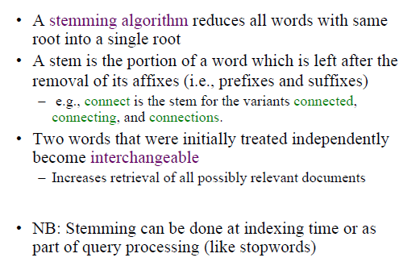
Stemming

Slide 27
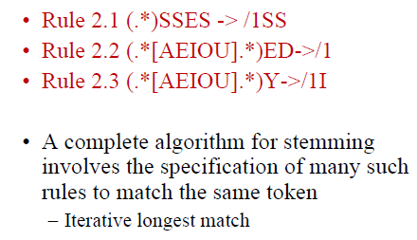
Context-sensitive Transformation Grammar

Slide 28
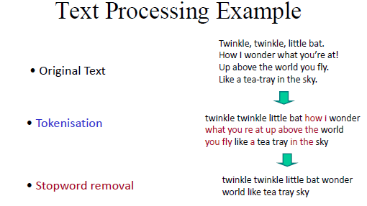

Slide 29
PART 2: INDEXING

Slide 30
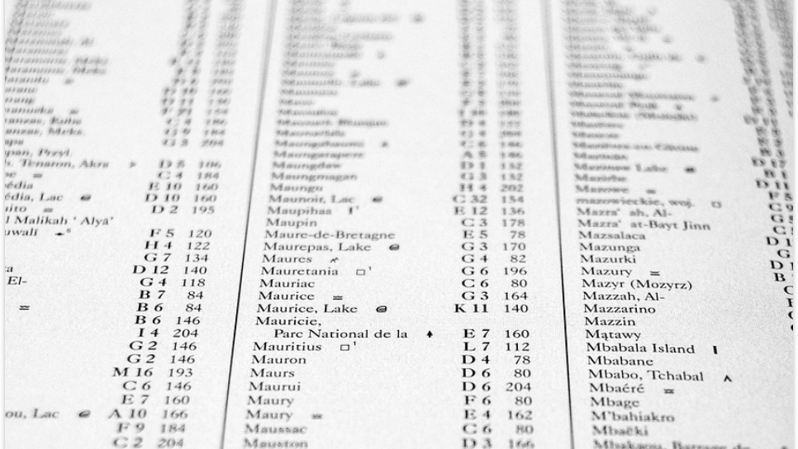
Inverted Index

Slide 31
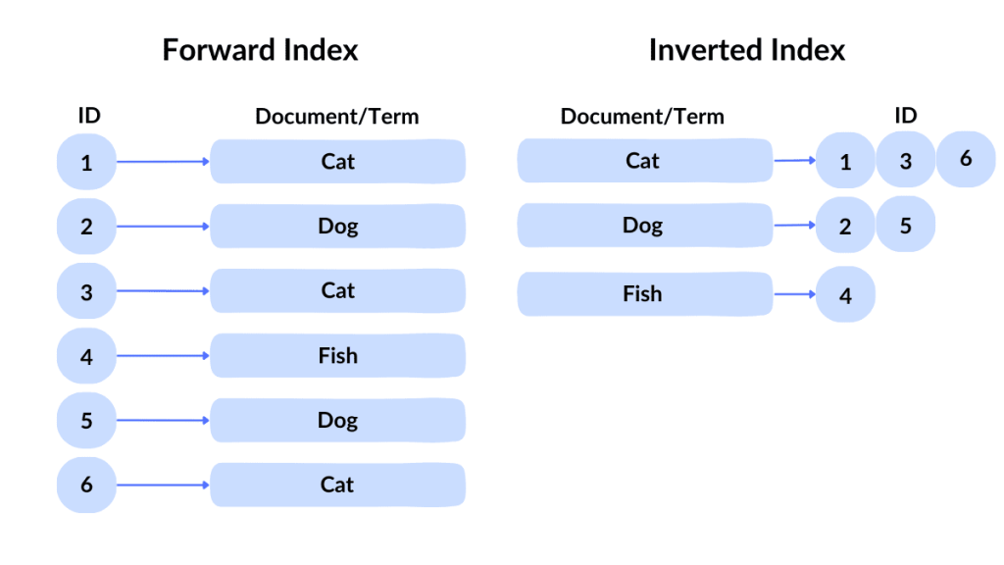
Inverted Index
https://spotintelligence.com/2023/10/30/inverted-indexing/

Slide 32
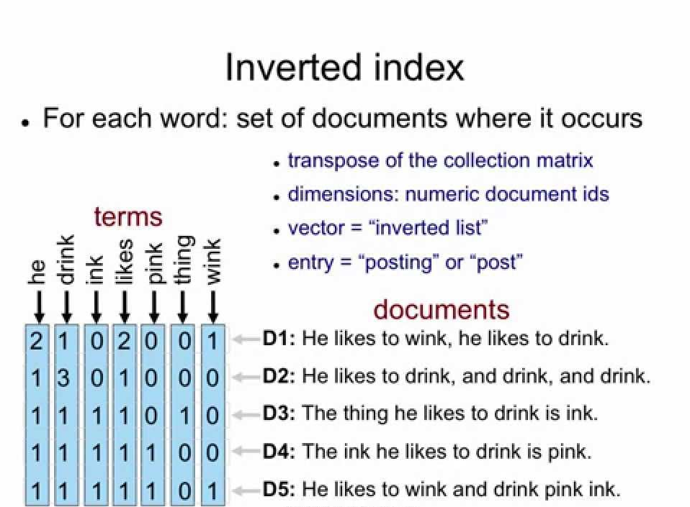

Slide 33
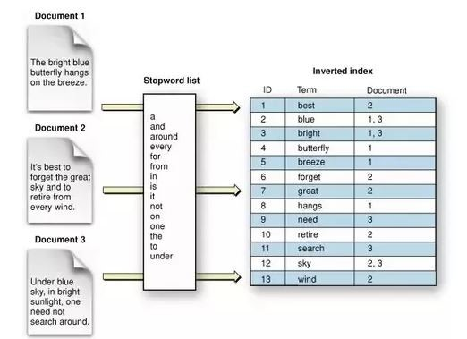

Slide 34
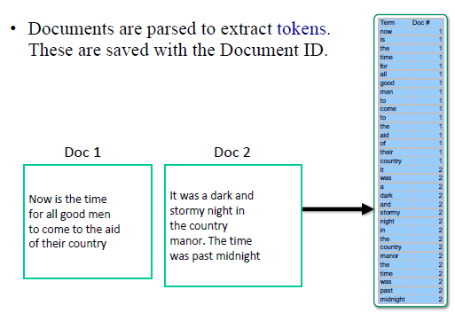
How Are Inverted Files Created

Slide 35
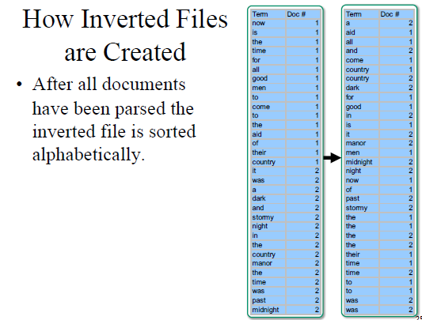

Slide 36
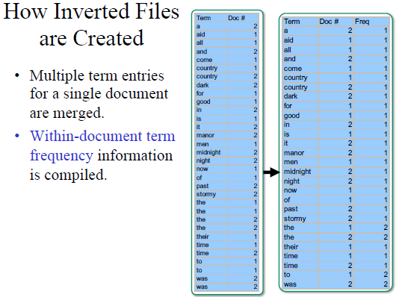

Slide 37
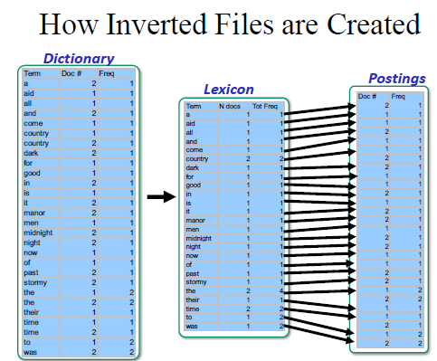

Slide 38
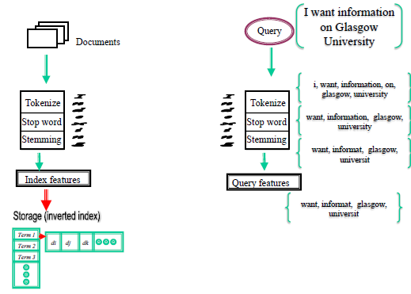

Slide 39
PART 3: RETRIEVAL

Slide 40
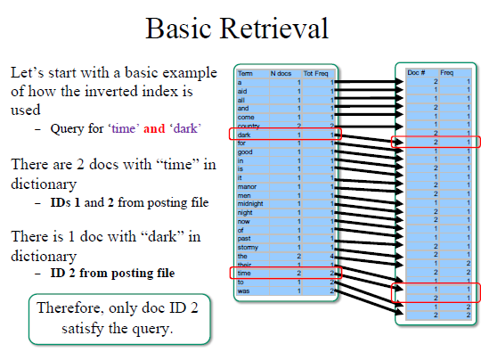

Slide 41
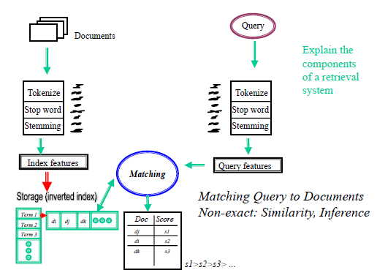

Slide 42
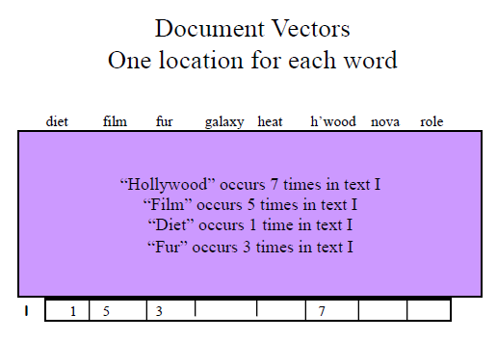

Slide 43
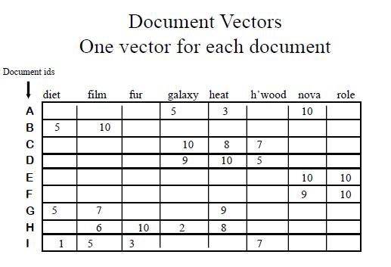

Slide 44
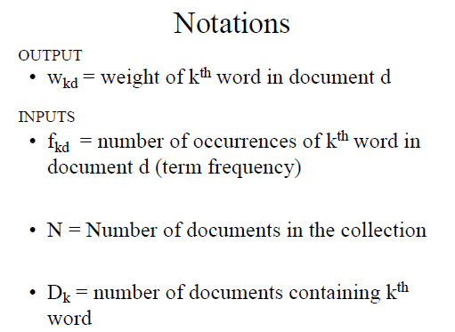

Slide 45
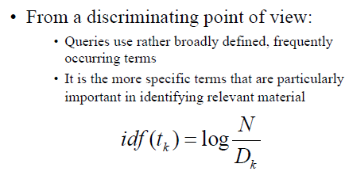
TF-IDF
TF: Term frequency
IDF: Inverse Document Frequency

Slide 46
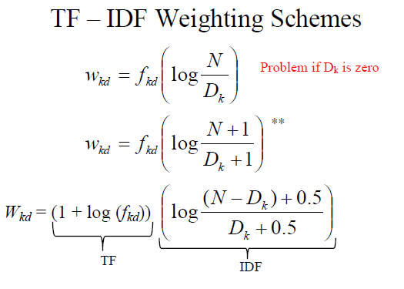

Slide 47
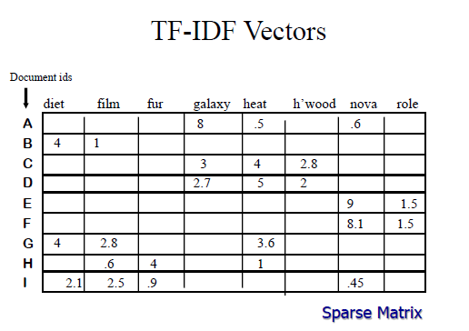

Slide 48
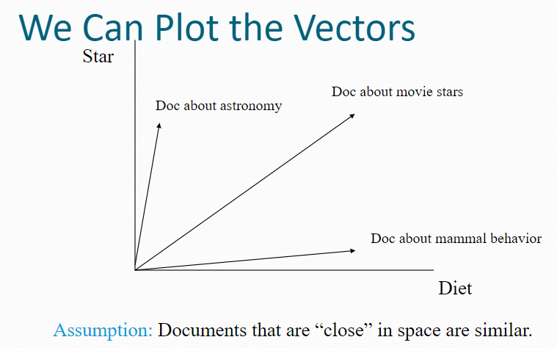

Slide 49
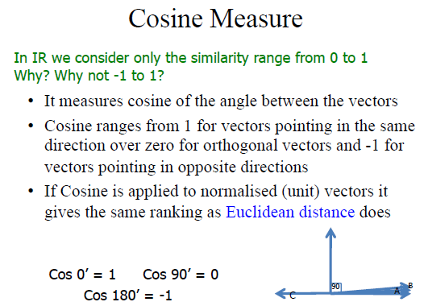

Slide 50
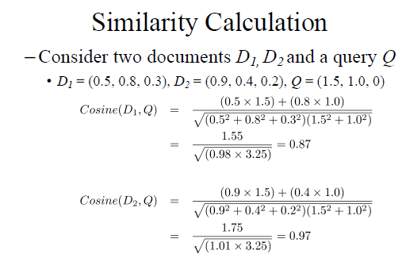

Slide 51
Evaluation Methodology

Slide 52
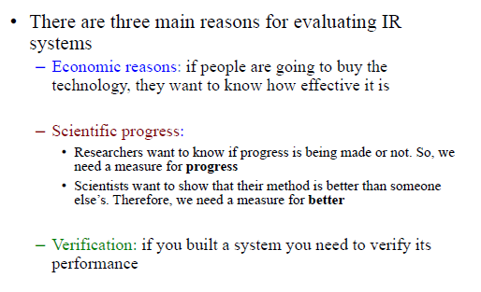
Why Evaluate?

Slide 53
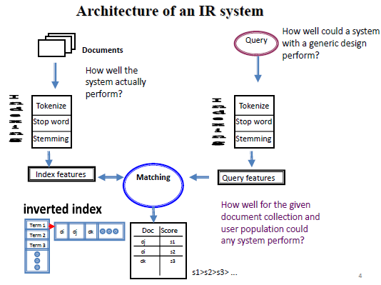

Slide 54
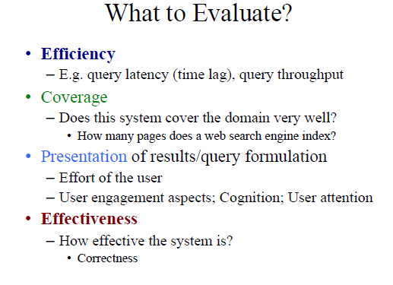

Slide 55
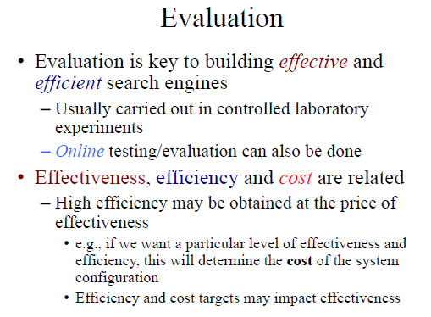

Slide 56
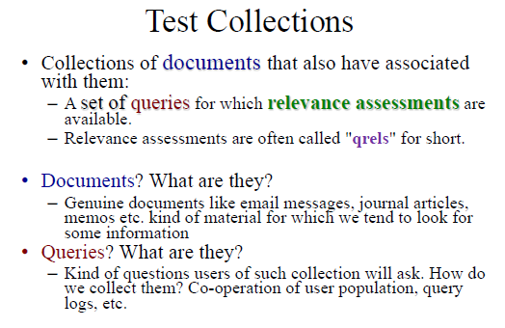

Slide 57
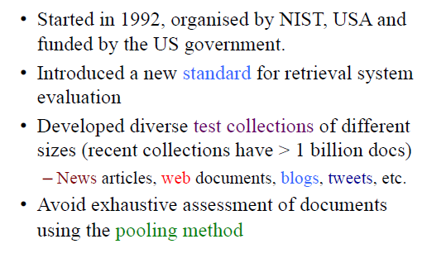
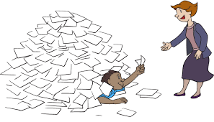
TREC: Text Retrieval Conference

Slide 58
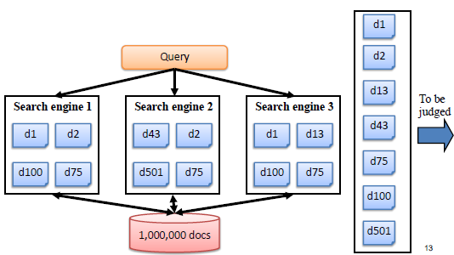

Slide 59
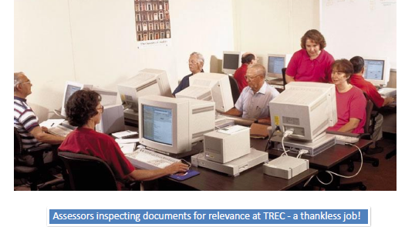

Slide 60
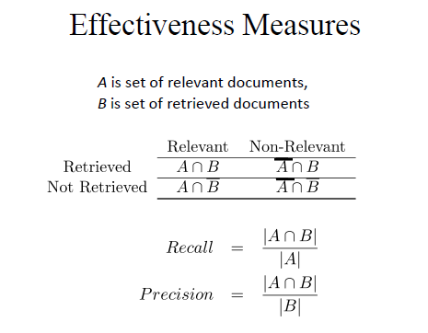

Slide 61
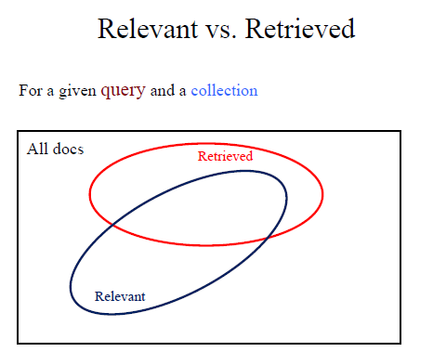

Slide 62
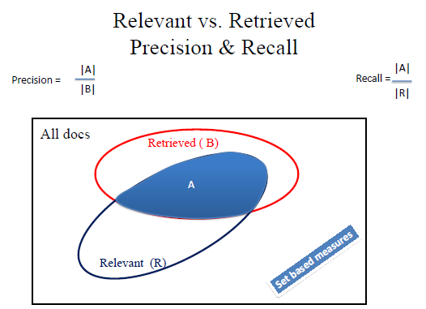

Slide 63
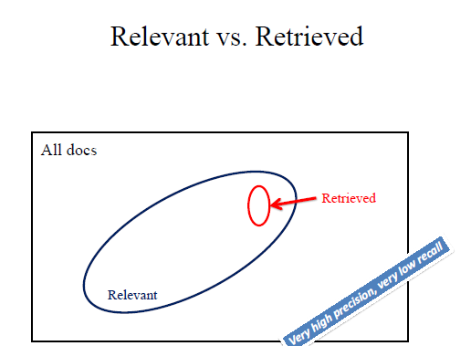

Slide 64
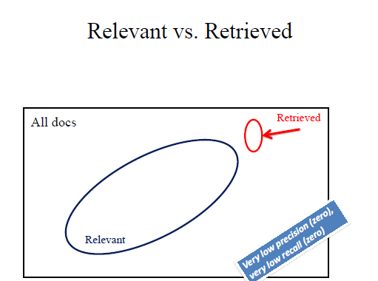

Slide 65
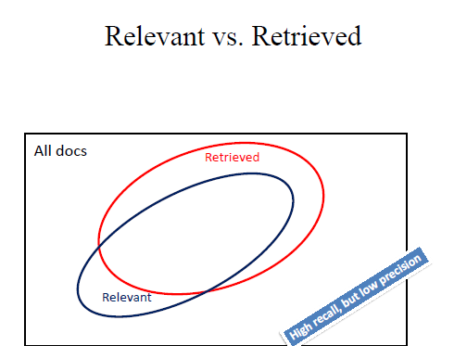

Slide 66


Slide 67


Slide 68


Slide 69


Slide 70


Slide 71


Slide 72


Slide 73


Slide 74


Slide 75


Slide 76


Slide 77


Slide 78


Slide 79


Slide 80

Py-

Slide 81

Pyterrier
https://github.com/terrier-org/pyterrier

Slide 82
Dense Retriever

Slide 83
Sparse vs Dense
Who is the bad guy in lord of the rings?
Top-k
Docs
Sauron
Indexer
Retriever
tf-idf, BM25
Docs
Ranked
Read
Retrieve
Index

Slide 84
Sparse vs Dense
Sala Baker is best known for portraying the villain Sauron in the Lord of the Rings trilogy
Who is the bad guy in lord of the rings?
Sauron
Question
Answer
Context

Slide 85

Sparse vs Dense

Slide 86

Dense Retrieval

Slide 87

Similarity
Cosine Similarity:
Dot Product:

Slide 88

DPR

Slide 89

ColBERT

Slide 90

GTR

Slide 91
Task/domain specific
dataset
RAG = Retrieval + Generation (LLM)
Fine-tuning
Response
Query
{ }
Pre-training
Response
Gigantic dataset
(web, wiki, books, news, etc)
LLM (Generation)
Q/A System
User
Search
Reduce Hallucinate
Query + relevant docs
Knowledge/documents
Retrieval

Slide 92


https://www.llamaindex.ai/

